Slide 1

VIVEKANAND EDUCATION SOCIETY'S INSTITUTE OF TECHNOLOGY
DEPARTMENT OF INFORMATION TECHNOLOGY
FLUTTER
PRESENTATION
PRESENTED BY
AAKANKSHA SUVARNA
ROLL NO: 65
CLASS: D15B
BATCH: C
GUIDED BY:
DR. RAVITA MISHRA

Slide 2
FLUTTER
PRESENTATION
Wedding Planning Application
NAME: AAKANKSHA SUVARNA
ROLL NO: 65
CLASS: D15B

Slide 3

TABLE OF CONTENTS
Introduction
Literature survey
Authentication
Problem statement
UML Diagram
Conclusion
Objectives and Features
Implementation
References

Slide 4

INTRODUCTION
WeddingPlanning is an application tailored to simplify user’s wedding preparations. It serves as a complete companion from the moment of engagement to the celebration of the user's special day.
With the WeddingPlanning application, users can personalize every aspect of their wedding. From managing their budget to selecting venues, coordinating with vendors, deciding on invitation modes, and more, all customization options are conveniently available in one place. Users can experience the ease of planning their dream wedding with this Wedding Planning Application!
11

Slide 5
PROBLEM STATEMENT
Planning a wedding can be overwhelming for many couples, as they juggle various decisions and details like budgeting, venue selection, attire, and catering. Without a simple, all-in-one solution, couples often feel stressed and struggle to find resources that meet their needs. There's a need for a user-friendly tool that makes wedding planning easier, reduces stress, and helps couples create their dream day hassle-free.
The current market lacks personalized options for wedding planning apps. Existing websites typically offer services based solely on the total budget, overlooking the nuanced preferences of couples.

Slide 6
OBJECTIVES
01
02
03
04
SIMPLIFY WEDDING PLANNING
ENHANCE ORGANIZATION
PROMOTE PERSONALIZATION
HASSLE-FREE
To make the wedding planning process as smooth and hassle-free as possible, allowing users to focus on enjoying the journey towards their special day without unnecessary complications or stress.
To help users stay organized throughout the entire wedding planning journey, from budgeting and vendor selection to guest management and day-of coordination.
To offer customizable features and options that allow users to personalize their wedding planning experience according to their unique preferences and style.
To streamline the wedding planning process and make it more accessible for users of all backgrounds and experience levels.

Slide 7
FEATURES
01
02
03
05
04
ENTER WEDDING DETAILS
WEDDING DRESS SELECTION
VENUE SELECTION
INVITATION CARD OPTIONS
CATERING SERVICES
Users can choose between destination weddings or standard banquet venues, tailored to their budget
Explore catering services for weddings on the 'Wedding Details' page, with options for buffet or plated meal systems, allowing users to tailor their reception menu effortlessly.
Users can easily input their wedding budget and select their wedding date on the "Wedding Details" page, streamlining the initial planning process.
Explore a curated collection of wedding dresses and attire options for brides and grooms. Users can choose from designer or standard attire.
Choose from a variety of invitation card designs and styles, enabling users to personalize their invitations according to their preferences.

Slide 8
LITERATURE SURVEY
Author | Title | link
Jhonatan Zacchi | VR to view the destination | http://eprints.utar.edu.my/4262/1/17ACB01592_FYP.pdf
Yee Lip Por | Web-Based Wedding_Planner with Comparative Analysis | https://www.researchgate.net/publication/228877585_An_Interactive_Web-Based_Wedding_Planner_with_Comparative_Analysis_Decision_Support_System
Website | Wed me good | https://www.wedmegood.com/

Slide 9
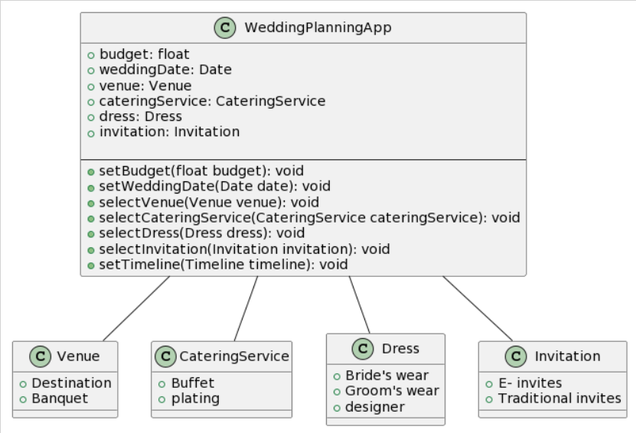
UML DIAGRAM

Slide 10
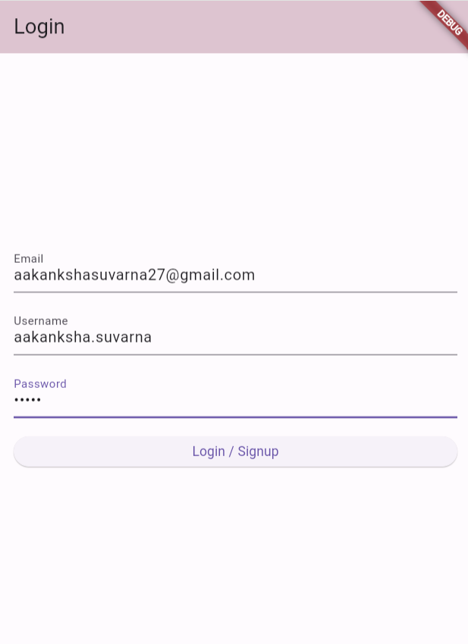
IMPLEMENTATION
LOGIN PAGE

Slide 11
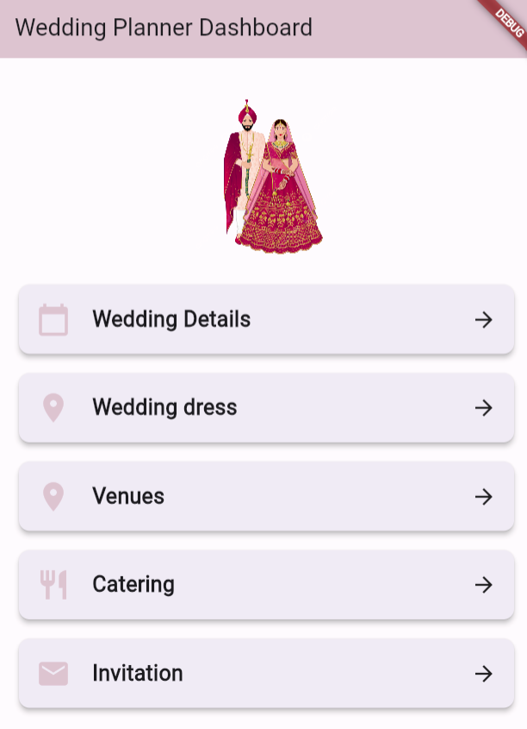
IMPLEMENTATION
DASHBOARD

Slide 12
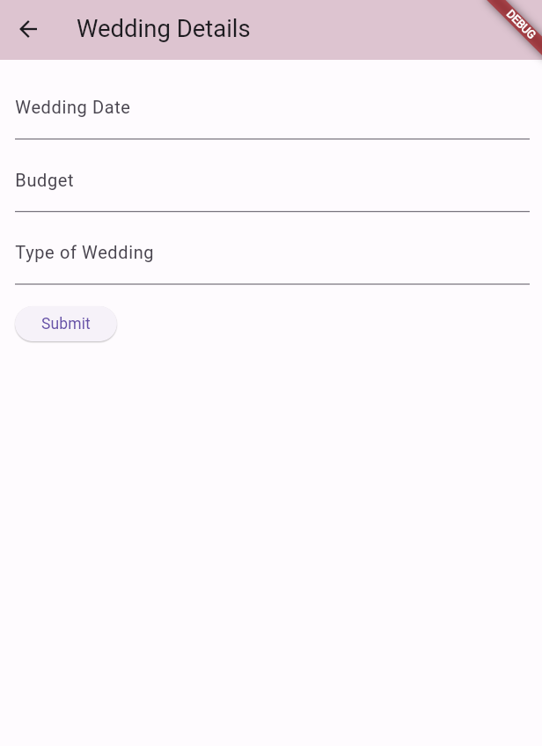
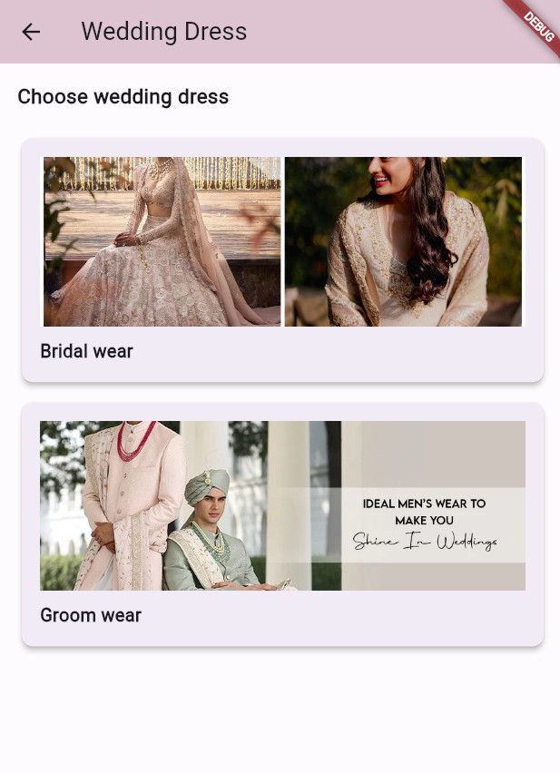
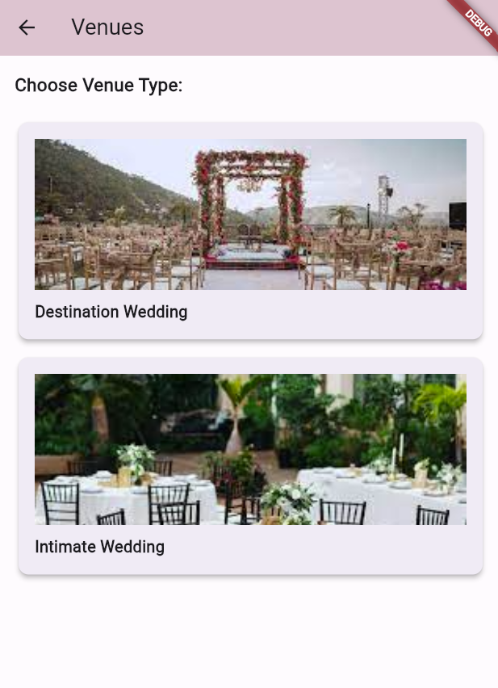
IMPLEMENTATION
WEDDING DETAILS
WEDDING DRESS
VENUES

Slide 13
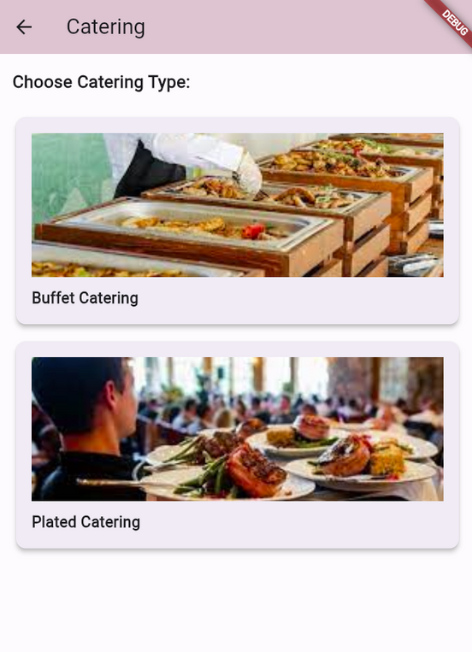
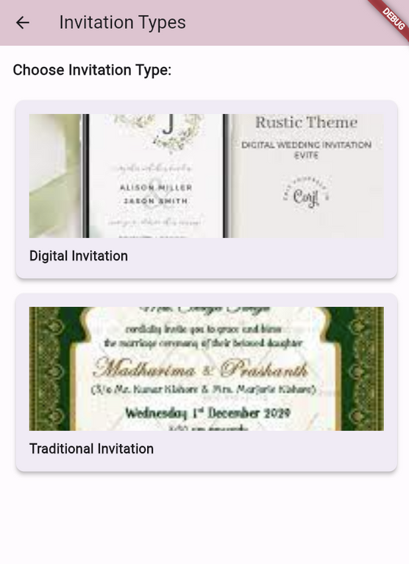
IMPLEMENTATION
CATERING
INVITATION TYPE

Slide 14
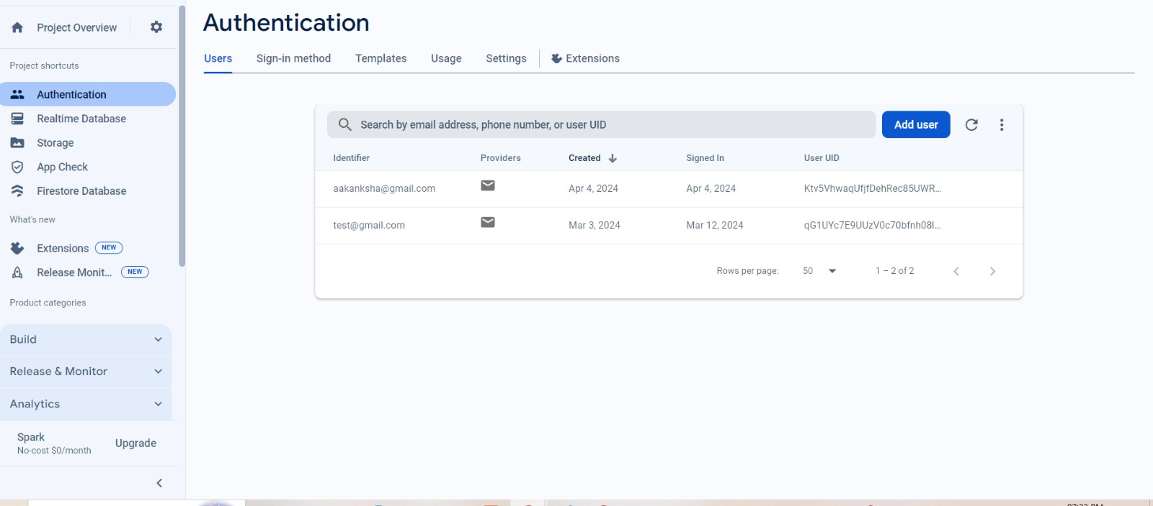
AUTHENTICATION

Slide 15
CONCLUSION
In conclusion, Wedding Planning offers a comprehensive and user-friendly platform for couples embarking on their journey to a memorable wedding day.
From initial budgeting and venue selection to attire choices and catering preferences, our app simplifies every step of the planning process.
With customizable options tailored to individual needs, such as selecting between buffet or plated meal systems, Wedding Planning ensures that every detail is seamlessly coordinated.
With Wedding Planning, couples can embark on their wedding journey with confidence, knowing that their dream day is just a few taps away.

Slide 16
REFERENCES
http://eprints.utar.edu.my/4262/1/17ACB01592_FYP.pdf : This project is developed to build a mobile application for users to do their wedding planning and venue design tasks in an efficient way after surveying the available systems in the market.
https://www.researchgate.net/publication/228877585_An_Interactive_Web-Based_Wedding_Planner_with_Comparative_Analysis_Decision_Support_System: for the brides and grooms to retrieve information on available bridal products and services in the shortest possible time
https://www.wedmegood.com/ : Indian Wedding Planning Website and app where you can find the best wedding vendors, with prices and reviews at the click of a button

Slide 17
PROGRESSIVE
WEB
PRESENTATION
Hair Accessories Store
NAME: AAKANKSHA SUVARNA
ROLL NO: 65
CLASS: D15B

Slide 18
TABLE OF CONTENTS
Performance ananlysis with Google lighthouse
Introduction
Fetch event
Implementation
Push event
Conclusion
Service worker in PWA
Sync event

Slide 19
WHAT IS PWA
Cross-Platform Compatibility: PWAs work seamlessly across various devices and platforms, reducing the need for separate development efforts for different operating systems.
Improved User Experience: They offer fast loading times, offline access, and smooth navigation, enhancing user satisfaction and engagement.
Cost-Efficiency and Accessibility: Developing a PWA involves lower costs compared to native apps, and their accessibility via URLs eliminates the need for app store downloads, making them more convenient for users.

Slide 20
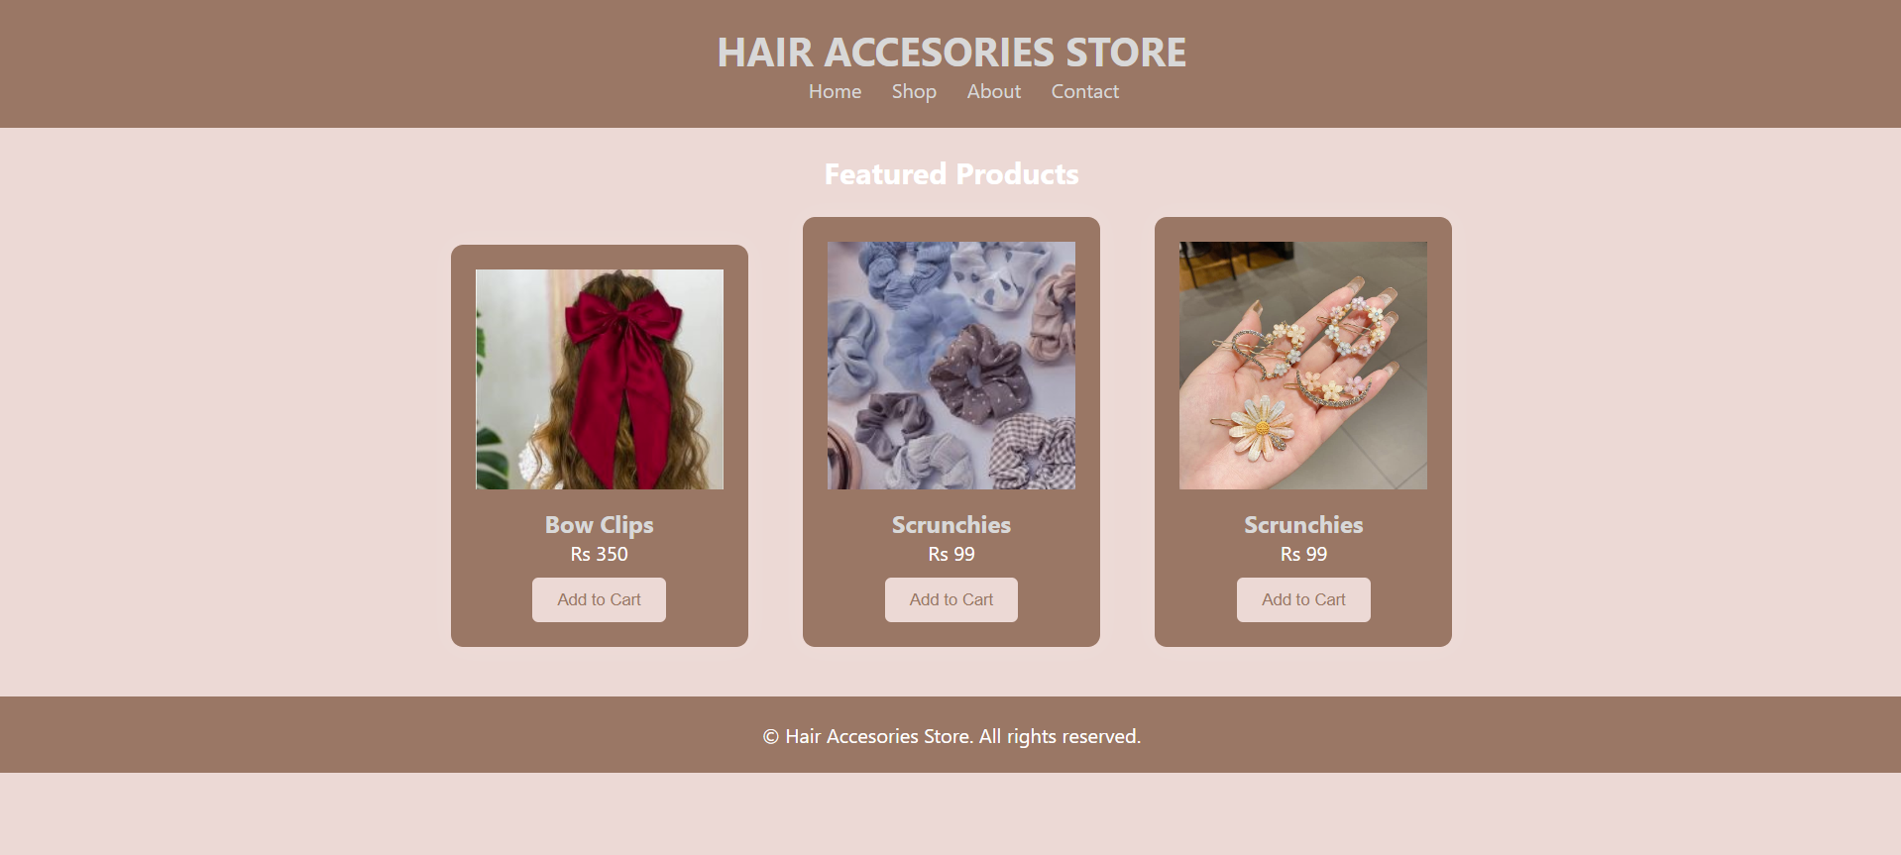
IMPLEMENTATION

Slide 21
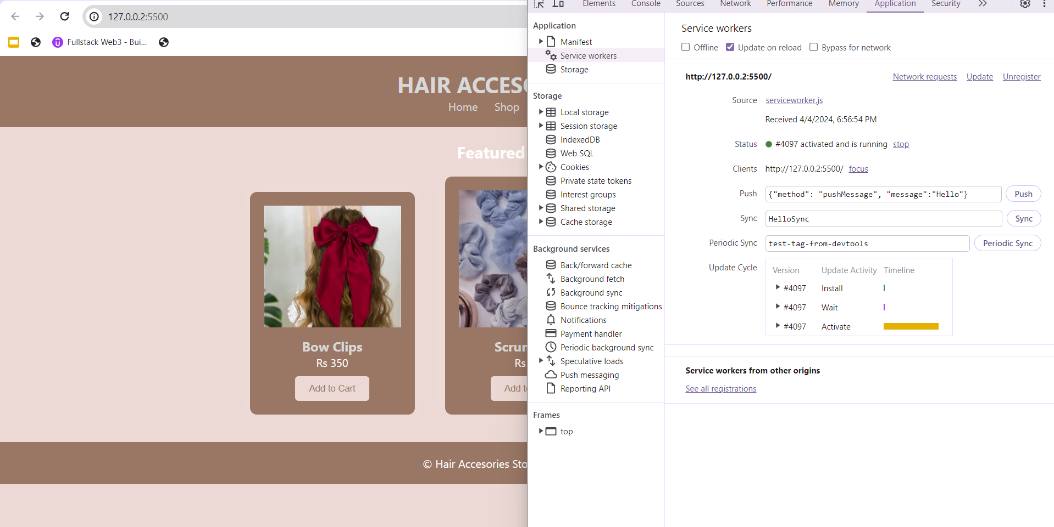
SERVICE WORKER IN PWA

Slide 22
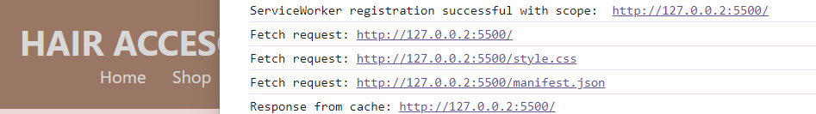
FETCH EVENT
The fetch event in a ServiceWorker triggers whenever the browser fetches a resource. It allows the ServiceWorker to intercept network requests, enabling tasks like caching resources for offline use, fetching resources from the network, or executing custom logic on requests and responses.

Slide 23
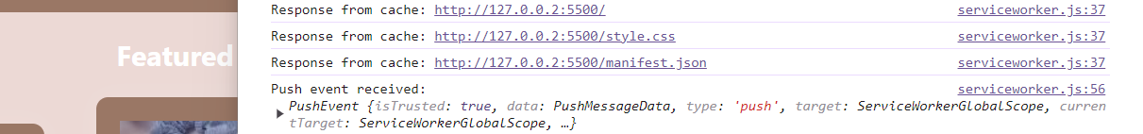
PUSH EVENT
The push event in a ServiceWorker is triggered when the browser receives a push notification from a server. It allows the ServiceWorker to handle the incoming notification, typically by displaying it to the user or performing background tasks based on the notification's content.

Slide 24
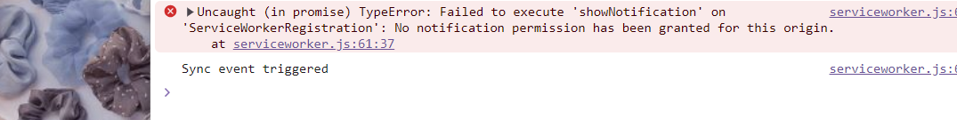
SYNC EVENT
The sync event in a Service Worker allows background synchronization tasks, enabling offline web apps to update data when the network is available. It's triggered when the browser reconnects to the internet after being offline, providing a retry mechanism for failed synchronization attempts.

Slide 25
PERFORMANCE ANALYSIS WITH GOOGLE LIGHTHOUSE
Google Lighthouse is an open-source tool developed by Google that helps developers improve the quality and performance of web pages and web applications.
It is commonly used to audit and analyze various aspects of a website, including performance, accessibility, best practices, SEO (Search Engine Optimization), and Progressive Web App (PWA) functionality.

Slide 26
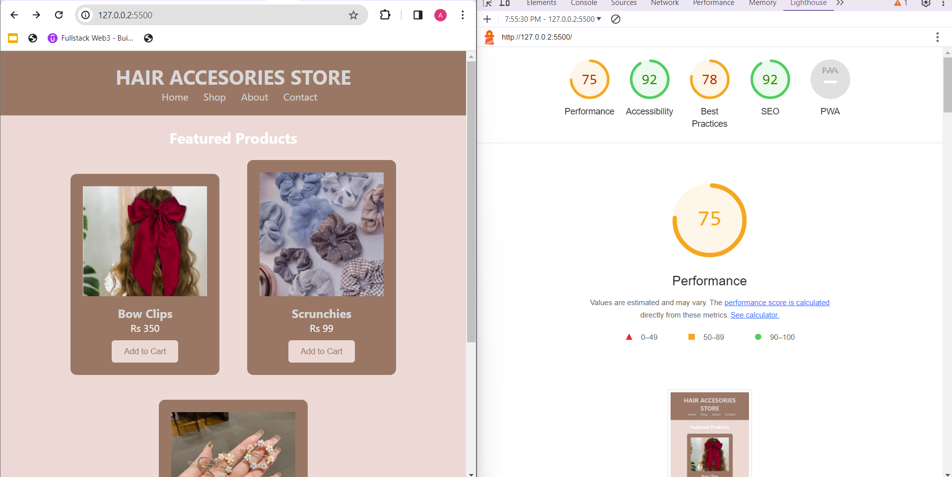
PERFORMANCE ANALYSIS WITH GOOGLE LIGHTHOUSE

Slide 27
CONCLUSION
In conclusion, our journey in developing the E-commerce Progressive Web Application (PWA) has been filled with significant accomplishments. From the initial setup and smooth registration of service workers to the successful implementation of features like fetching data, sending push notifications, and syncing content seamlessly, we've effectively showcased the power and versatility of PWAs in modern web development.
The importance of PWAs for enhancing user experience cannot be overstated, and as we look to the future, there are ample opportunities for further enhancements and innovations in our E-commerce PWA, ensuring continued growth and success in the ever-evolving digital landscape.

Slide 28
FOR A
PATIENT HEARING
THANK YOU!

